Slide 1
ABUSING AZURE ACTIVE DIRECTORY
H A C K E R S A C A D E M Y . C O M
1

Slide 2
Introduction
Recon
Initial access Enumeration Persistence Privilege escalation
AGENDA

Slide 3
Check Access VM
RDP to the VM
Pause and close all Hyper-V instances Launch Internet Explorer then close it
Check Access to Azure Portal Username and password on the shared drive https://portal.azure.com
LOGISTICS
PowerShell Modules
Are pre-imported when you launch PS

Slide 4
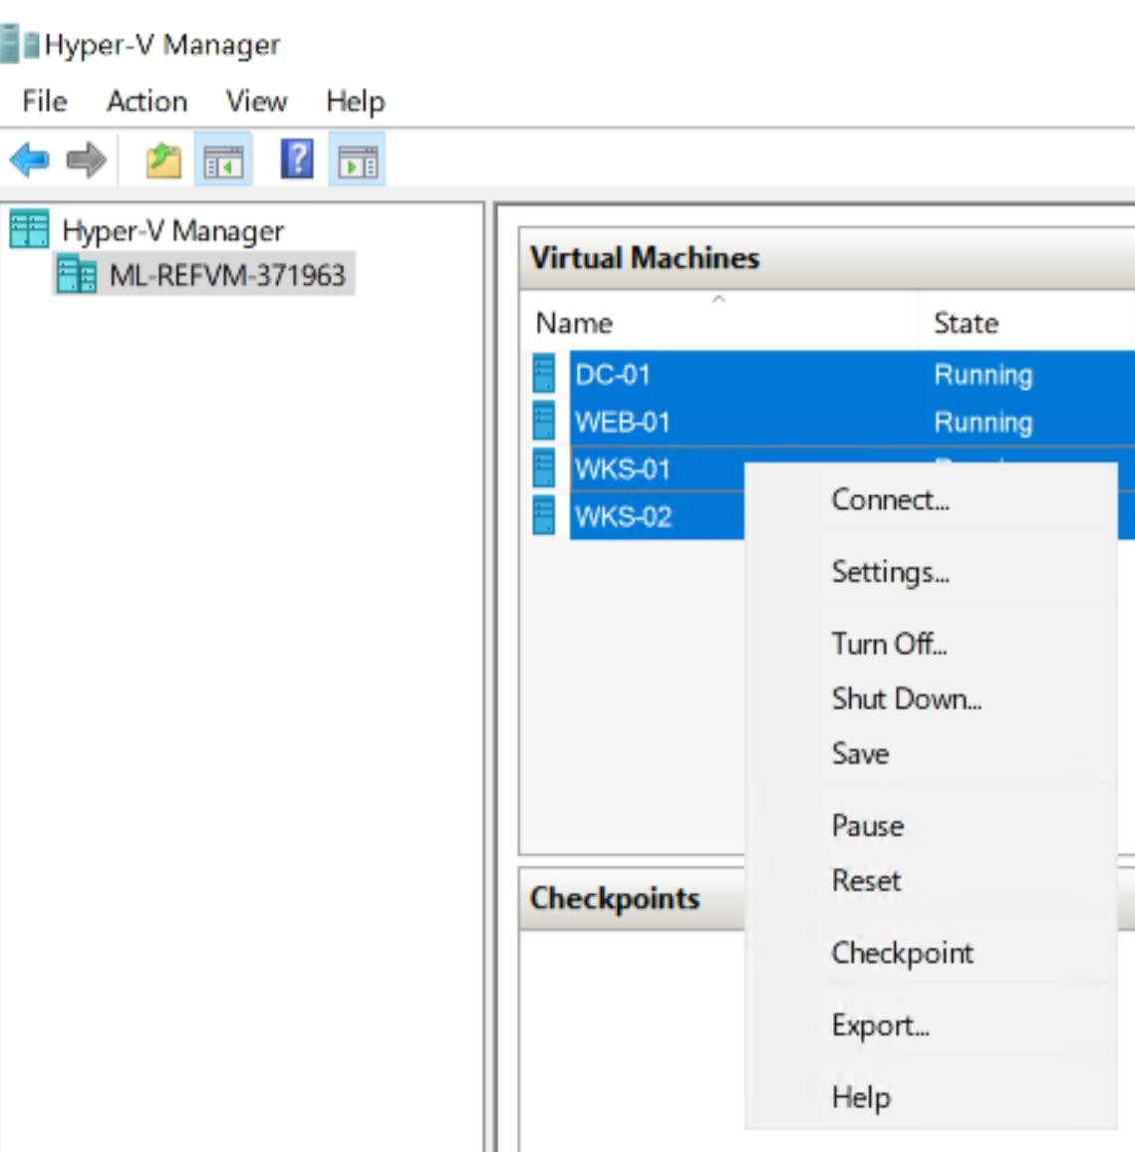
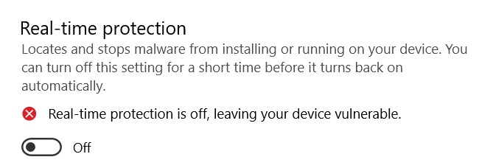

H A C K E R S A C A D E M Y . C O M

Slide 5
Alto.tel
Do they have Azure presence? What Azure services are they using?
Can we pivot from on-prem to the cloud? Can we breach the cloud?
OUR TARGET
H A C K E R S A C A D E M Y . C O M
6

Slide 6
INTRODUCTION

Slide 7
WHAT IS MS AZURE?
H A C K E R S A C A D E M Y . C O M

Slide 8
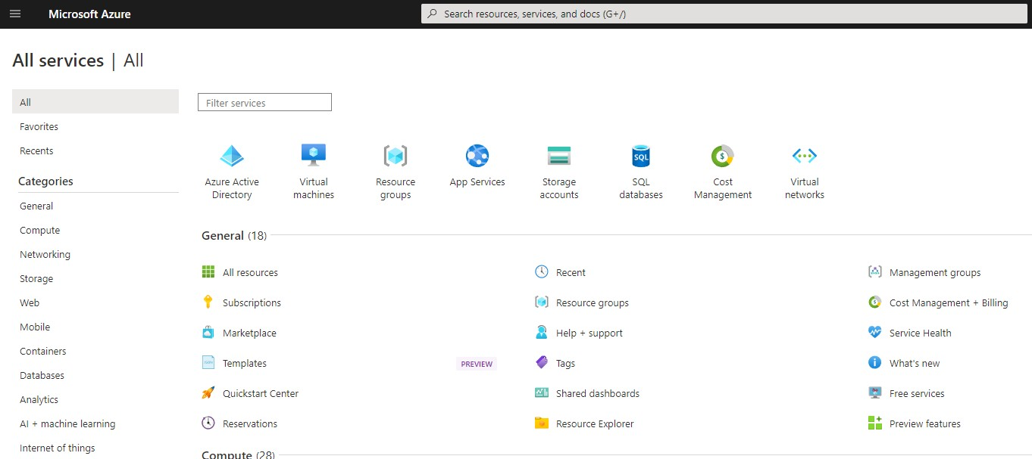
H A C K E R S A C A D E M Y . C O M

Slide 9
A collection of online services Hosted in MS datacenters around the world No need to build on-prem IT infra
Pay for what you use Scale up and down
WHAT IS IT?

Slide 10
Common Services
Compute Storage Networking Identity
WHAT IS IT?
Other Services
Devops Integration Analytics AI
IoT
Etc.

Slide 11
Compute Services
VMs
App Service Container Instances Function App Kubernetes Service
COMPUTE

Slide 12
Network Services
VNet Subnets VNet peering Azure VPN
Azure ExperssRoute
NETWORKING

Slide 13
Storage Services
Blob
File Storage Data lake SQL
DB for Open Source Synapse Analytics Cosmos DB
Cache for Redis
STORAGE

Slide 14
Identity Services Azure Active Directory AD Connect
Users Groups
IDENTITY

Slide 15
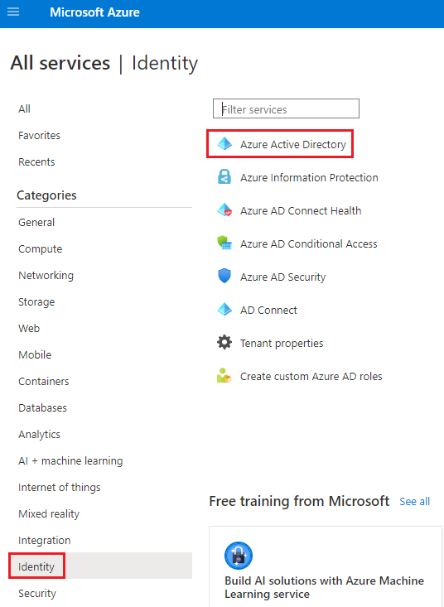
H A C K E R S A C A D E M Y . C O M

Slide 16
On-prem AD Domain Services
AKA AD or ADDS
Needs DCs
Authenticate using Kerberos or NTLM Extendable
Groups, users, OUs, GPOs, etc.
Domain admin, enterprise admin etc.
ON-PREM AD

Slide 17
Azure AD
Unlike on-prem AD
Cloud-based identity solution
Create a user on AAD and login to cloud apps Authenticate using SAML, OAuth, OpenID
Can sync on-prem users to the cloud (more later)
AZURE AD

Slide 18
Azure ADDS
Allows for using Kerberos and NTLM on the cloud Like on-prem AD but limited
It’s a Microsoft managed environment NOT an extension for on-prem AD
No GPO, no domain admin
AZURE ADDS

Slide 19
AZURE IMPORTANT CONCEPTS
20

Slide 20
SUBSCRIPTION & BILLING
Billing Account
An agreement between you and MS to use Azure services
Subscription
A grouping of resources Payment method and other info
You could have multiple subscription in your billing account

Slide 21
RESOURCE GROUP
A collection of resources
Subscription can have multiple resource groups

Slide 22
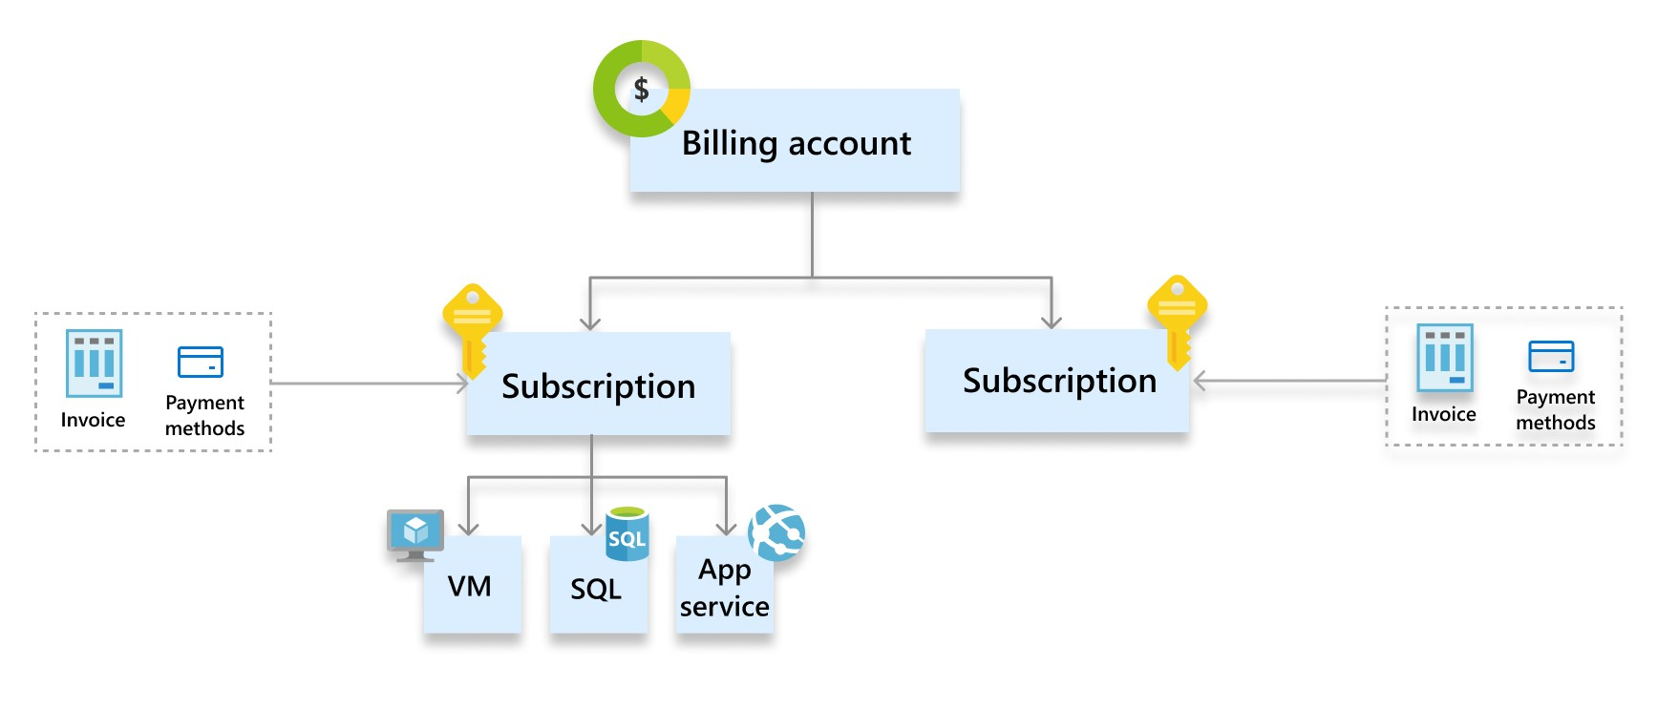
Source: https://docs.microsoft.com/en-us/azure/cost-management-billing/manage/view-all-accounts

Slide 23
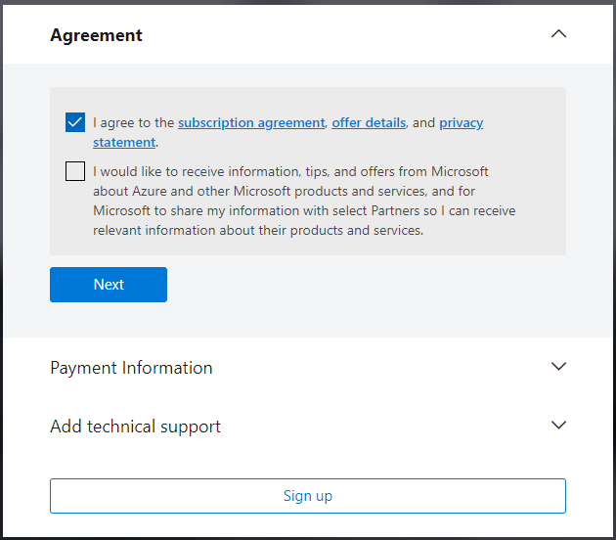
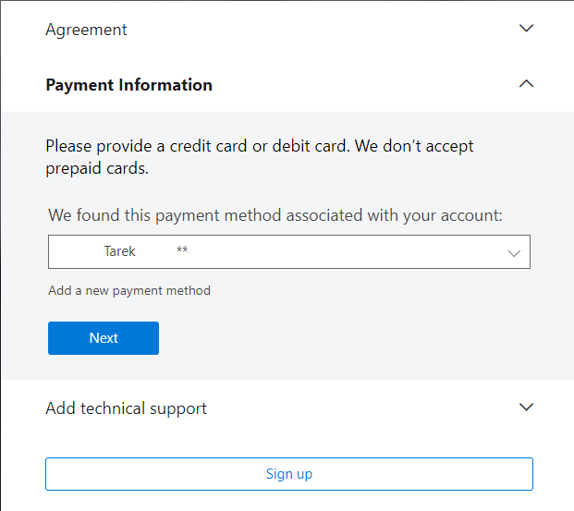

Slide 24
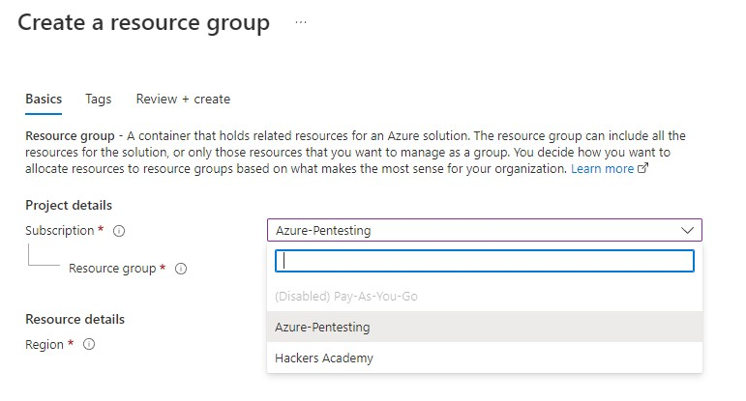
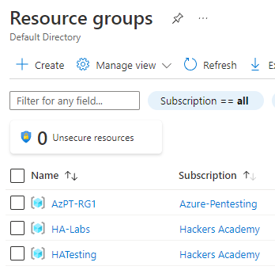

Slide 25
Could be
Pivot from on-prem Compromise AD VMs Password spraying/guessing Blobs
Phishing App consent Etc.
INITIAL ACCESS
H A C K E R S A C A D E M Y . C O M
26

Slide 26
AZURE AD CONNECT
H A C K E R S A C A D E M Y . C O M
27

Slide 27
Tool To Implement Hybrid Identity Sync on-prem users, groups and devices to cloud Password Hash Synchronization (PHS)
AZURE AD CONNECT
Creates users on-prem and on-cloud

Slide 28
Sync Accounts
MSOL_123xyz
Used for sync operations
Has “Replicating Directory” permissions i.e. PHS
Permissions to replicate directory changes, modify passwords,
modify users, modify groups, and so on
ON-PREM TWO USERS
Service Account Existing account… or… ADSyncMSA123abc Runs MS AD sync service
C:\Program Files\Microsoft Azure AD Sync\Bin\miiserver.exe

Slide 29
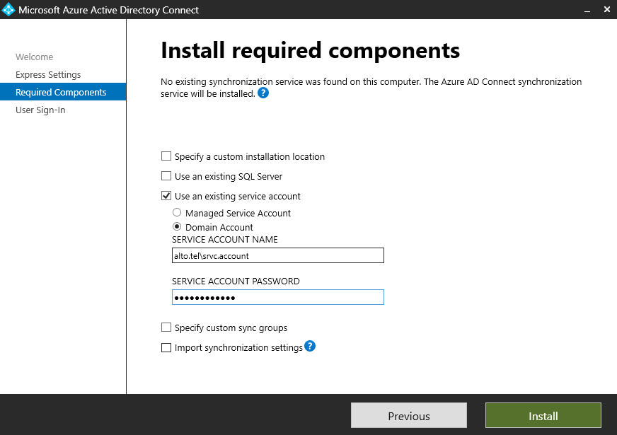

Slide 30
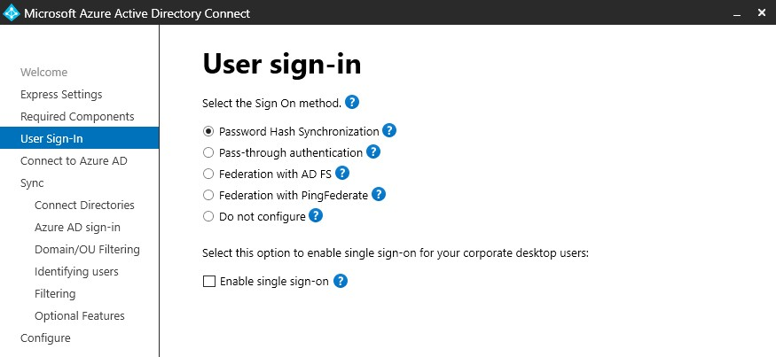

Slide 31
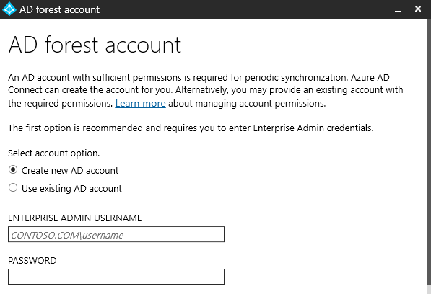

Slide 32
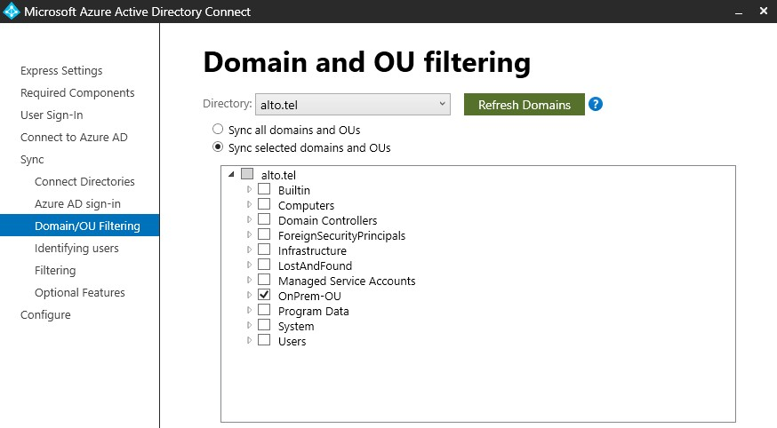

Slide 33
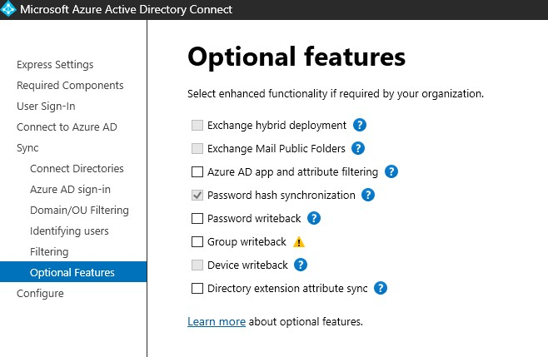



Slide 34
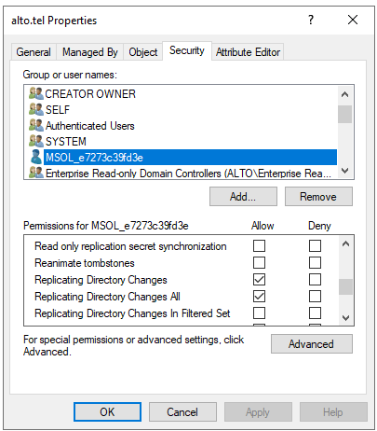



Slide 35
One Account
CLOUD SYNC USER
Sync_ServerName_123abc
Has role of Directory Synchronization Accounts
Only has permissions to perform directory synchronization tasks
H A C K E R S A C A D E M Y . C O M
36

Slide 36
H A C K E R S A C A D E M Y . C O M

Slide 37
Compromise Scenarios
Server with Azure AD Connect compromised Sync user created with guessable password User with password change/reset compromised
SYNC USER
DC Sync
Replication permissions allow for DC Sync attack
Perquisite: compromise sync user

Slide 38
DEV-1084
Post published 7 April 2023 Iranian linked APT
Adding local users and elevating to local admin
WMI
Azure AD Connect credentials to pivot to cloud
MERCURY & FRIENDS

Slide 39
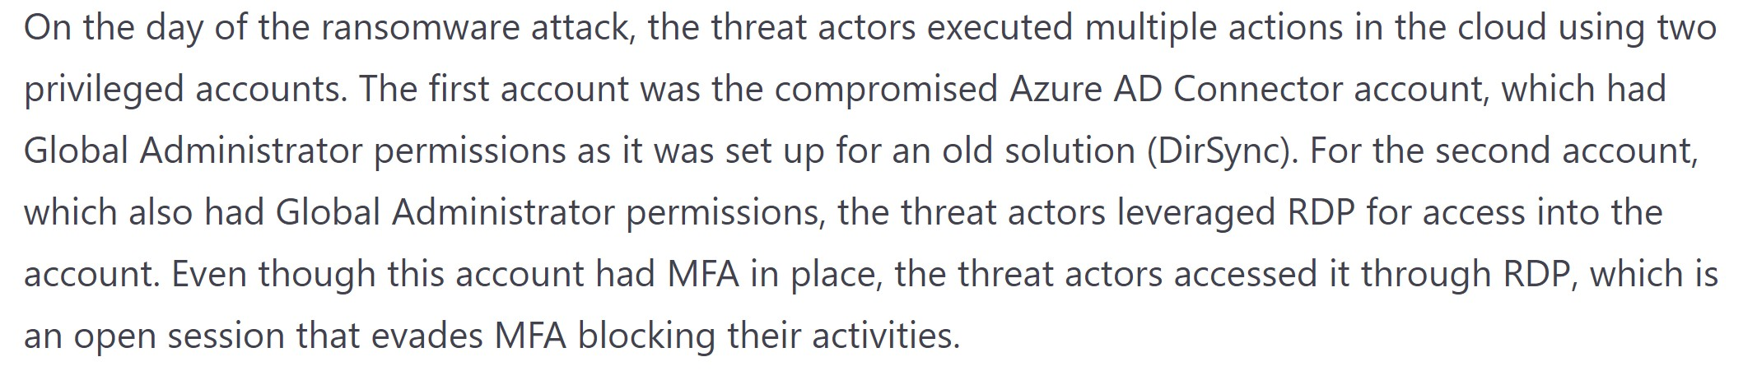

Slide 40
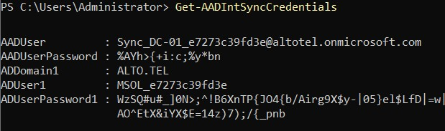

Slide 41
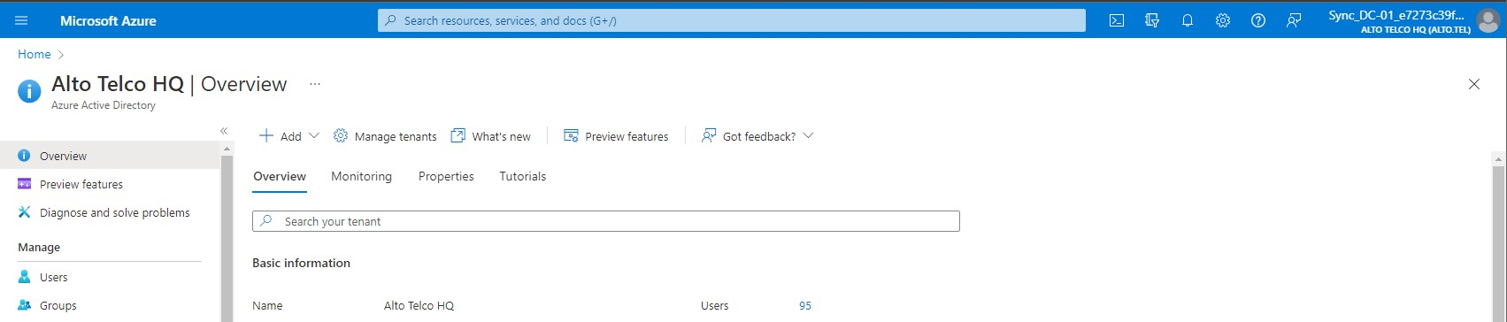


Slide 42
GET
AZURE AD
G e t - A z u r e A D D i r e c t o r y R o l e | w h e r e
{ $ _ . D i s p l a y N a m e - e q " D i r e c t o r y
S y n c h r o n i z a t i o n A c c o u n t s " } | G e t -
A z u r e A D D i r e c t o r y R o l e M e m b e r
SERVICE
ACCOUNTS

Slide 43
Enumerate
Initial Access – Password Spray Defense bypass – Conditional Access
Persistence – Guest user
Privilege Escalation – Dynamic Groups Privilege Escalation – Runbooks Privilege Escalation – Managed Identity Privilege Escalation – Key Vaults
STORY 1
44

Slide 44
RECON
45

Slide 45
Alto Telco
HQ in US
Branches in Japan, GB, India
OUR TARGET
alto.tel
H A C K E R S A C A D E M Y . C O M
46

Slide 46
TENANT AVAILABILITY
H A C K E R S A C A D E M Y . C O M
47

Slide 47
Tenant
Represents an organization
A dedicated instance of Azure AD
Like a domain on-prem
Contains things like:
Users
Groups
Devices
Apps
Etc.
TENANT
H A C K E R S A C A D E M Y . C O M
48

Slide 48
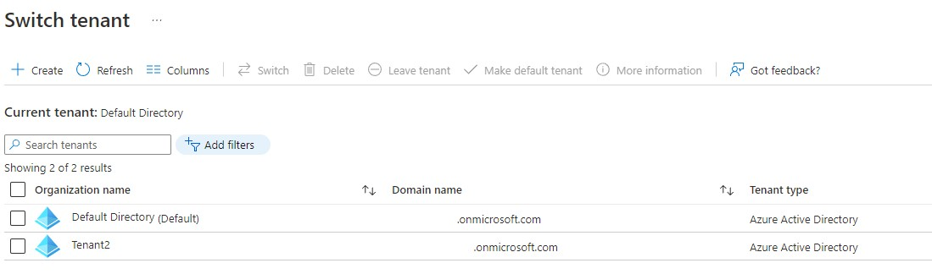
H A C K E R S A C A D E M Y . C O M

Slide 49


Default hackersacademy@hotmail.com.onmicrosoft.com hackersacademyhotmail.onmicrosoft.com
DOMAIN NAME
Custom
Whatever domain you own
alto.tel
H A C K E R S A C A D E M Y . C O M
50

Slide 50
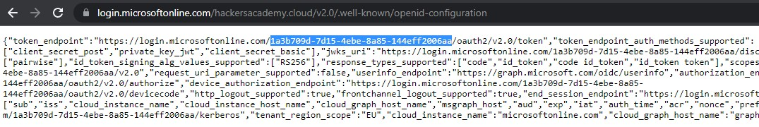

Slide 51
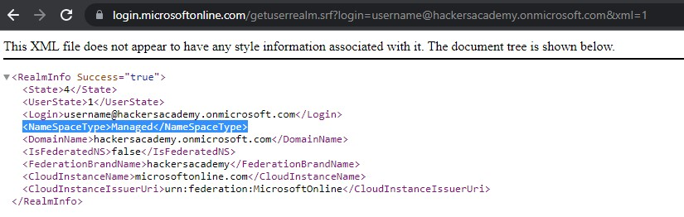

Slide 52
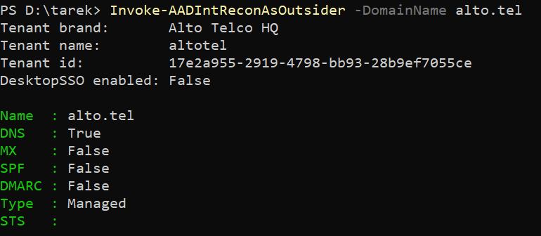

Slide 53
MISSION
U s e A A D I n t e r n a l s t o v a l i d a t e t e n a n t e x i s t e n c e

Slide 54
( P r e - d o n e ) I n s t a l l - M o d u l e A A D I n t e r n a l s
MISSION SOLUTION
( P r e - d o n e ) I m p o r t - M o d u l e A A D I n t e r n a l s
I n v o k e - A A D I n t R e c o n A s O u t s i d e r - D o m a i n N a m e
a l t o . t e l | F o r m a t - Ta b l e

Slide 55
SERVICES
56

Slide 56
Known Subdomains azure-api.net cloudapp.net scm.azurewebsites.net azurewebsites.net documents.azure.com database.windows.net
mail.protection.outlook.co vault.azure.net onmicrosoft.com sharepoint.com queue.core.windows.net blob.core.windows.net file.core.windows.net table.core.windows.net
SERVICES
H A C K E R S A C A D E M Y . C O M
57

Slide 57
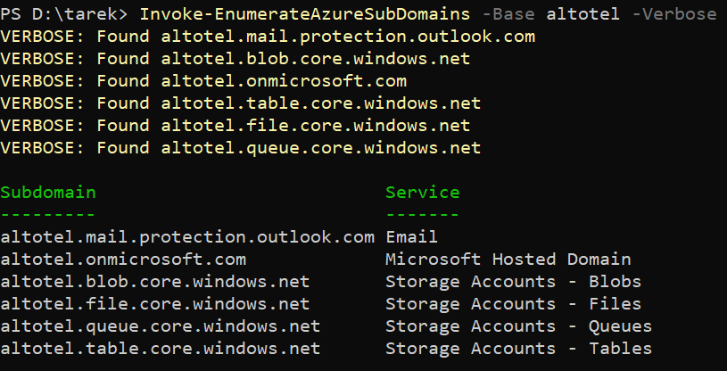

Slide 58
MISSION
U s e M i c r o b u r s t t o e n u m e r a t e s u b d o m a i n s

Slide 59
I m p o r t - M o d u l e ' . \ A z To o l s \ M i c r o B u r s t - m a s t e r \ M i c r o B u r s t . p s m 1 ’
MISSION SOLUTION
I n v o k e - E n u m e r a t e A z u r e S u b D o m a i n s - B a s e a l t o t e l
- V e r b o s e

Slide 60
USER ENUMERATION
61

Slide 61
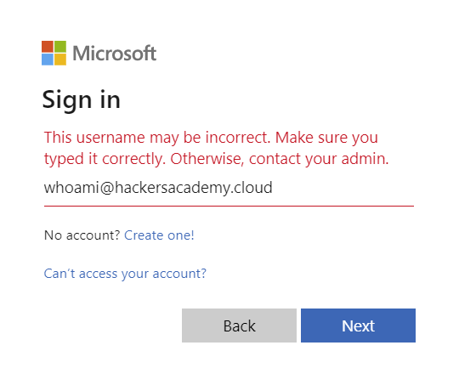
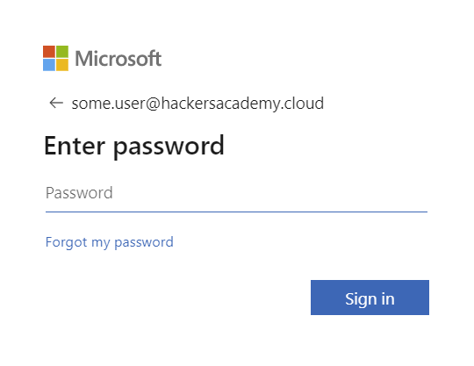
H A C K E R S A C A D E M Y . C O M

Slide 62
Authenticate to MSOL
API calls to:
login.microsoftonline.com/common/GetCredentialType
LOGIN TO MSOL
IfExistsResult | = | 0 | Valid Account
IfExistsResult | = | 1 | Invalid Account
H A C K E R S A C A D E M Y . C O M
63

Slide 63
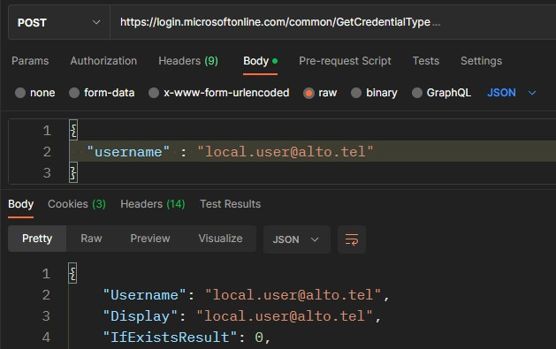
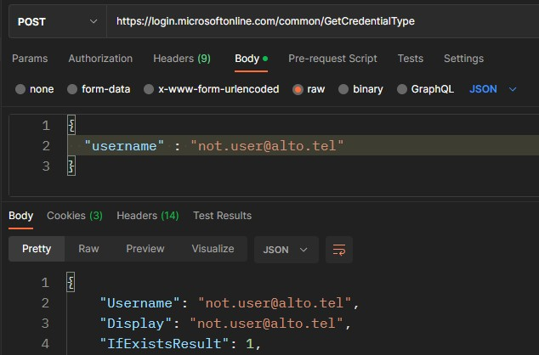

Slide 64
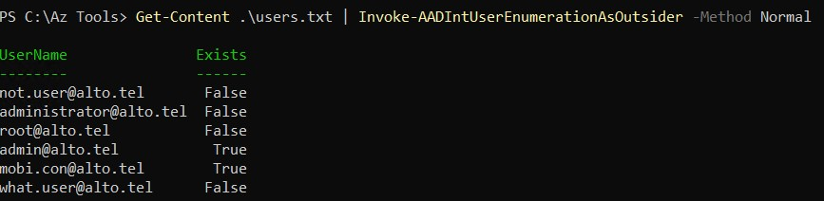

Slide 65
MISSION
U s e A A D I n t e r n a l s t o e n u m e r a t e u s e r s

Slide 66
MISSION SOLUTION
G e t - C o n t e n t u s e r s . t x t | I n v o k e -
A A D I n t U s e r E n u m e r a t i o n A s O u t s i d e r

Slide 67
Enumerate
Initial Access – Password Spray Defense bypass – Conditional Access
Persistence – Guest user
Privilege Escalation – Dynamic Groups Privilege Escalation – Runbooks Privilege Escalation – Managed Identity Privilege Escalation – Key Vaults
STORY 1

Slide 68
INITIAL ACCESS
69

Slide 69
Could be
Pivot from on-prem Compromise AD VMs Password spraying/guessing Blobs
Phishing App consent Etc.
INITIAL ACCESS
H A C K E R S A C A D E M Y . C O M
70

Slide 70
PASSWORD SPRAYING
H A C K E R S A C A D E M Y . C O M
71

Slide 71
Use a single password
PASSWORD SPRAYING
Against multiple accounts
Done against different API endpoints
Workaround account lockouts
Noisy!

Slide 72
API Call
https://login.microsoft.com/common/oauth2/token
PASSWORD SPRAYING
Done against different API endpoints AADSTS50034 User doesn’t exist AADSTS50126 Invalid password
AaDSTS50079 OR AADSTS 50076 MFA response
AADSTS50057 Disabled account
AADSTS50055 Password expired

Slide 73
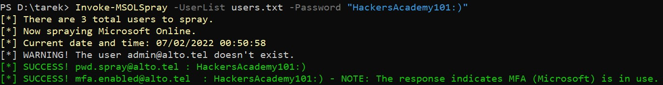
" B H @ A s i a 2 0 2 3 "

Slide 74
L o g i n u s i n g p w d . s p r a y @ a l t o . t e l
T r y l o g g i n g i n u s i n g m o b i . c o n @ a l t o . t e l N o t e d o w n y o u r p e r m i s s i o n s
MISSION
N o t e i n f o r m a t i o n a b o u t t h e G r o u p s
E x t r a m i l e
: U s e P o w e r S h e l l i n s t e a d o f t h e p o r t a l

Slide 75
MISSION SOLUTION
I n v o k e - M S O L S p r a y - U s e r L i s t . \ M S O L S p r a y -
m a s t e r \ m y u s e r s . t x t - P a s s w o r d B H @ A s i a 2 0 2 3

Slide 76
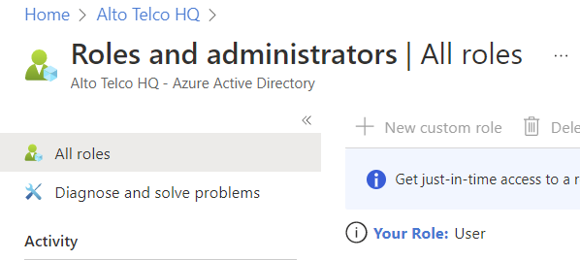


MISSION SOLUTION

Slide 77
W h a t d o e s t h e b e l o w e r r o r m e a n ? D o w e h a v e t h e c o r r e c t p a s s w o r d ?
DISCUSSION
A c c e s s h a s b e e n b l o c k e d b y C o n d i t i o n a l A c c e s s p o l i c i e s

Slide 78
CONDITIONAL ACCESS POLICIES
79

Slide 79
Signal
User or group membership
Location Device Calculated risk
CONDITIONAL ACCESS POLICIES
Decision
Block
Allow, with MFA, required compliance, require app, etc.
H A C K E R S A C A D E M Y . C O M
80

Slide 80
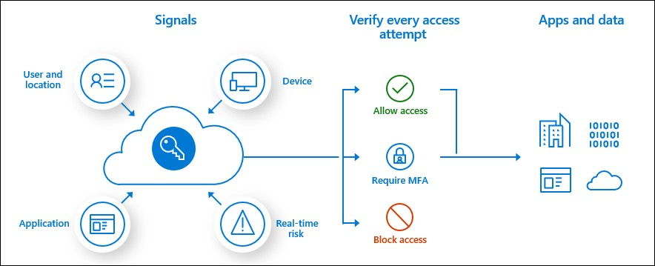
Source: https://docs.microsoft.com/en-us/azure/active-directory/conditional-access/overview

Slide 81
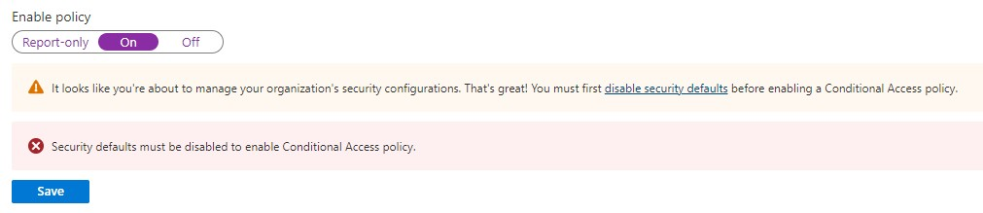
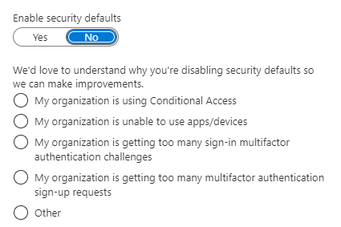

Slide 82
Security Defaults Off!
Requiring all users to register for Azure AD Multi-Factor Authentication.
Requiring administrators to do multi-factor authentication.
Requiring users to do multi-factor authentication when
necessary.
Blocking legacy authentication protocols.
Protecting privileged activities like access to the Azure portal.
SECURITY DEFAULTS OFF
https://docs.microsoft.com/en-us/azure/active-directory/fundamentals/concept- fundamentals-security-defaults
H A C K E R S A C A D E M Y . C O M
83

Slide 83
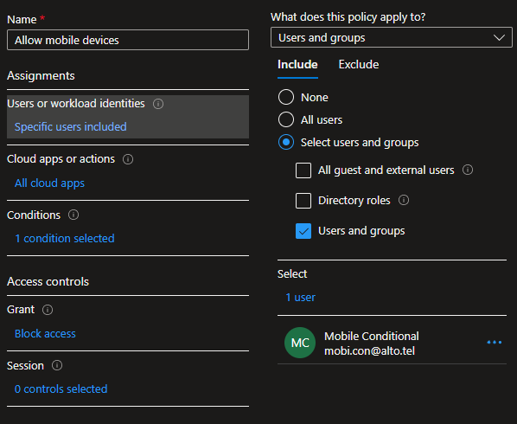
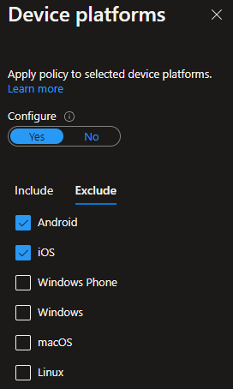
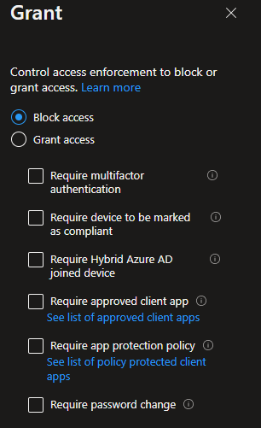





Slide 84
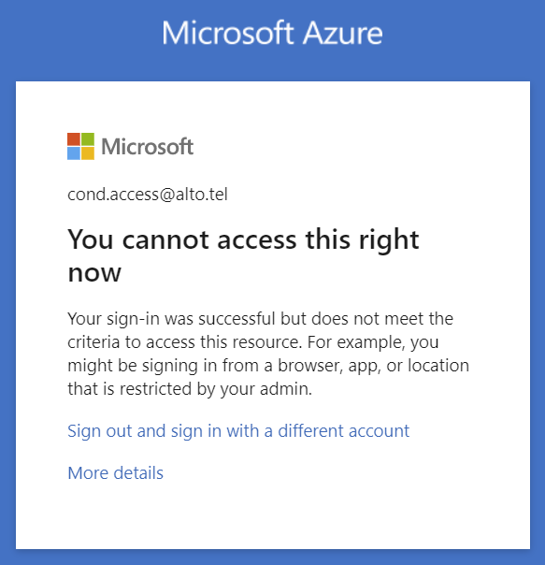

Slide 85
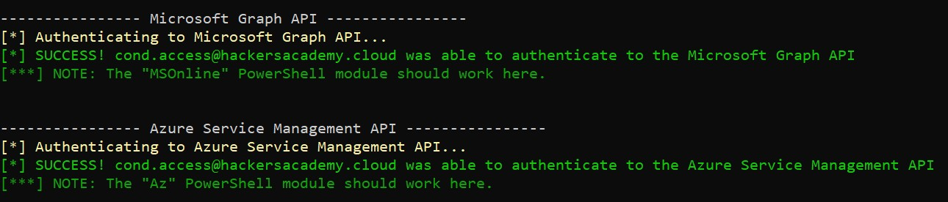
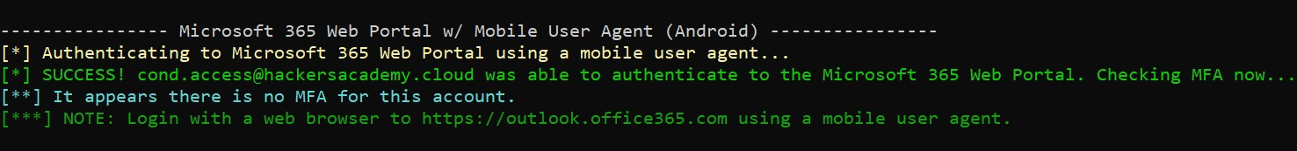

Slide 86

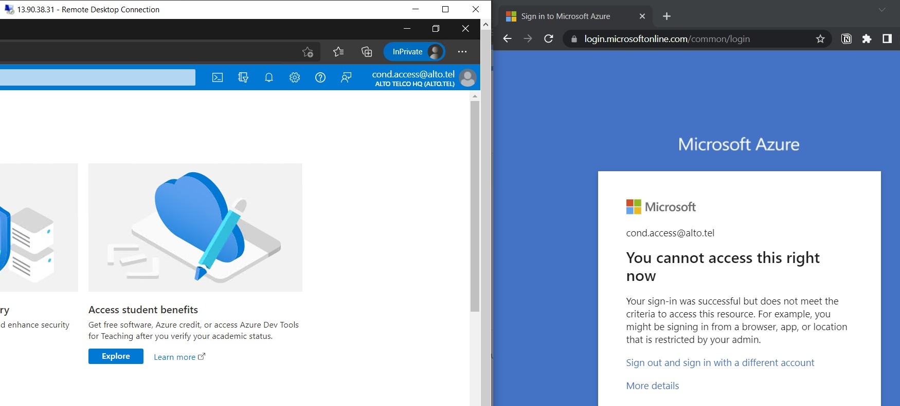



Slide 87
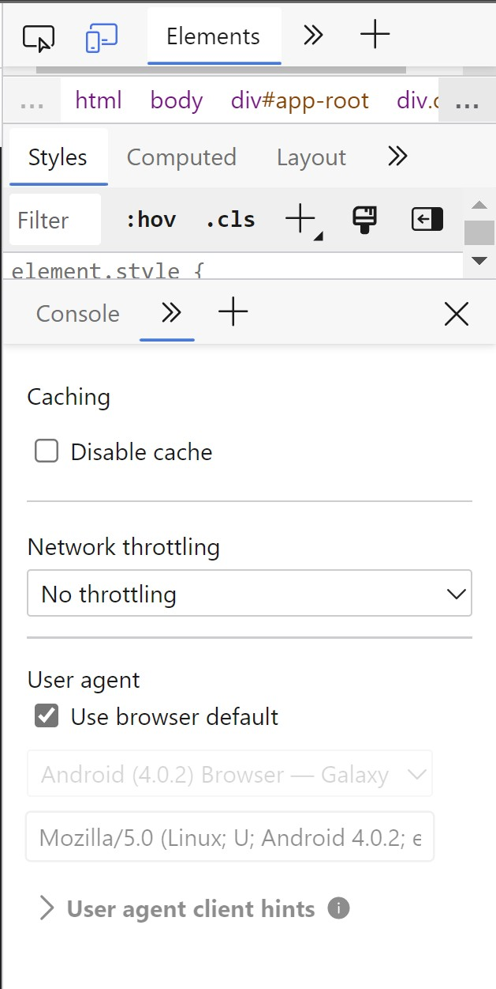

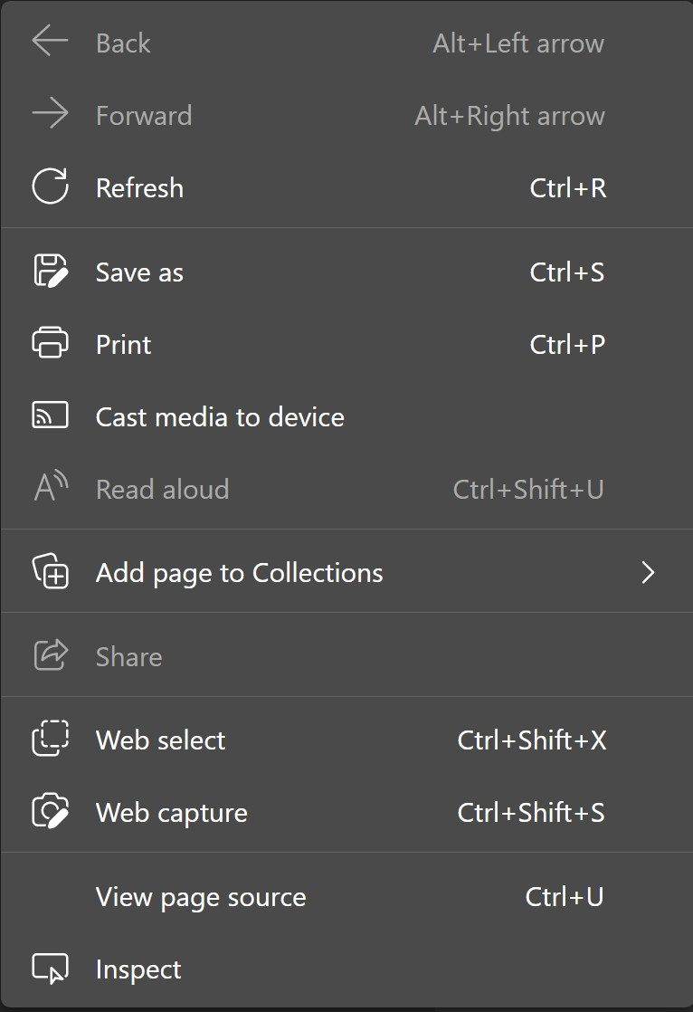


2
1

Slide 88
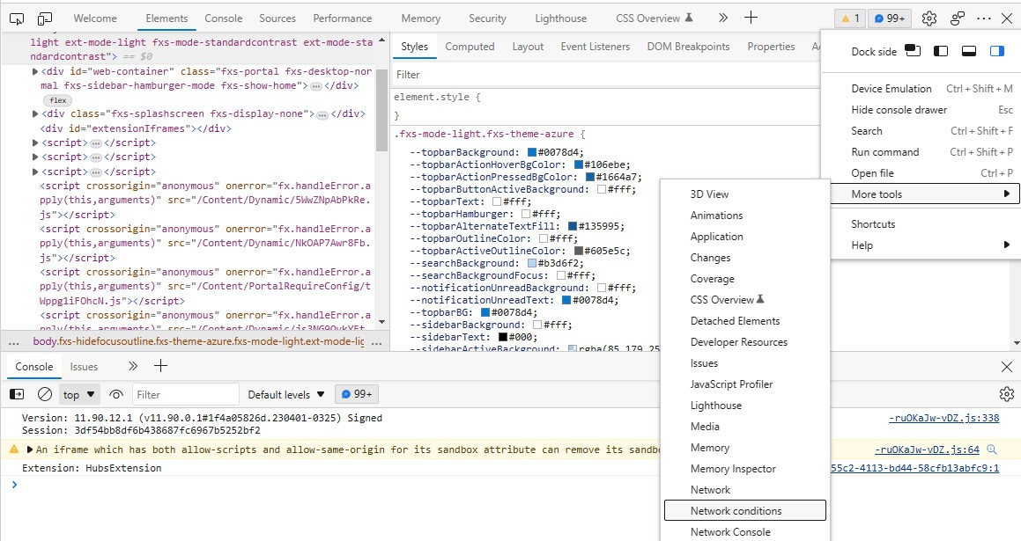


1
2

Slide 89
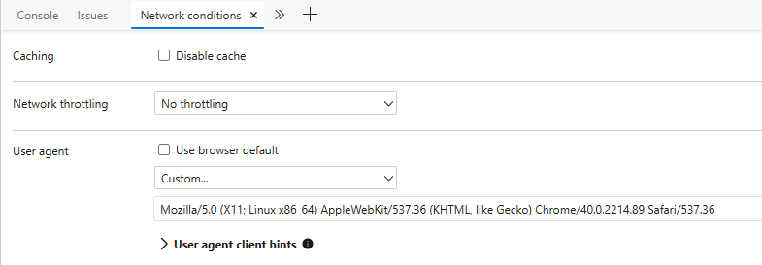


1
2

Slide 90
U s e M FA S w e e p a n d b y p a s s c o n d i t i o n a l a c c e s s o n m o b i . c o n @ a l t o . t e l
MISSION
H i n t : C h a n g e u s e r a g e n t b e f o r e y o u v i s i t t h e p o r t a l

Slide 91
MISSION SOLUTION
I n v o k e - M F A S w e e p - U s e r n a m e m o b i . c o n @ a l t o . t e l -
P a s s w o r d “B H @ A s i a 2 0 2 3 "

Slide 92
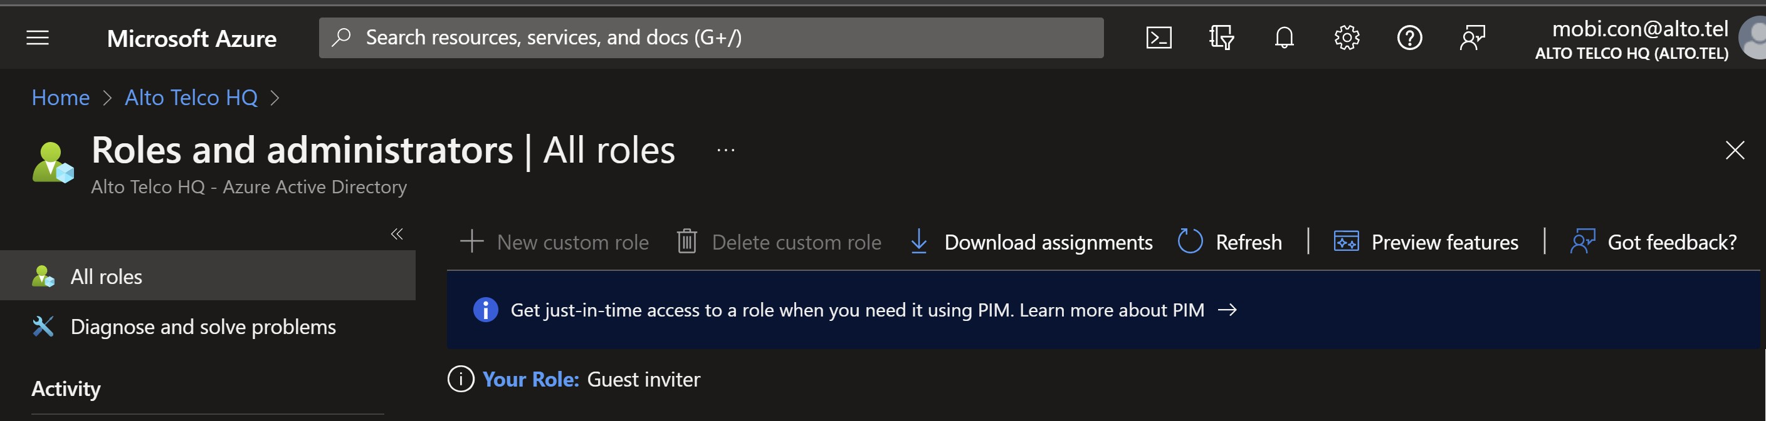



Slide 93
DISCUSSION
W h a t c a n m o b i . c o n @ a l t o . t e l d o t h a t
p w d . s p r a y @ a l t o . t e l c a n n o t ?

Slide 94
Enumerate
Initial Access – Password Spray Defense bypass – Conditional Access
Persistence – Guest user
Privilege Escalation – Dynamic Groups Privilege Escalation – Runbooks Privilege Escalation – Managed Identity Privilege Escalation – Key Vaults
STORY 1

Slide 95
AZURE AD ROLES
&
AZURE RBAC ROLES
96

Slide 96
Definition
Azure AD roles control access to Azure AD resources such as
users, groups, and applications using the Microsoft Graph API
Differs from Azure RBAC for resources
DEFINITION
Components
Security Principal – an ID (user, group or service principal)
Role Definition – collection of permissions
Scope – where the permissions apply
H A C K E R S A C A D E M Y . C O M
97

Slide 97
SECURITY PRINCIPAL
H A C K E R S A C A D E M Y . C O M
98

Slide 98
Definition
Azure AD roles control access to Azure AD resources such as
users, groups, and applications using the Microsoft Graph API
Differs from Azure RBAC for resources
DEFINITION
Components
Security Principal – an ID (user, group or service principal)
Role Definition – collection of permissions
Scope – where the permissions apply

Slide 99
Security Principals
Azure object that we want to assign privileges to
User, group, or service principal
Will have an Object ID
SECURITY PRINCIPALS
NOT a Service Principal
More later

Slide 100
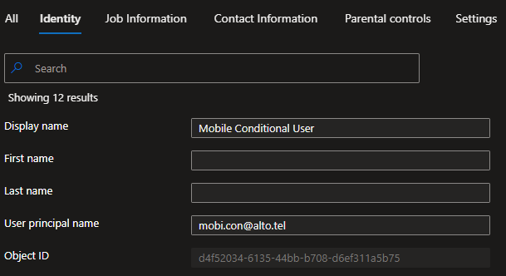


UPN
Security Principal

Slide 101
Two Types
Azure AD On-prem AD
USERS
User Principal Name
In AAD, UPN (usually email) identifies the user

Slide 102
Two Types Security Group Microsoft 365
GROUPS
Assignment Assigned Dynamic User Dynamic Device

Slide 103
Attribute-based rules
DYNAMIC GROUPS
Adds and remove members automatically Can be for device or users (not both)
When attribute of user or device changes, they’re re-evaluated

Slide 104
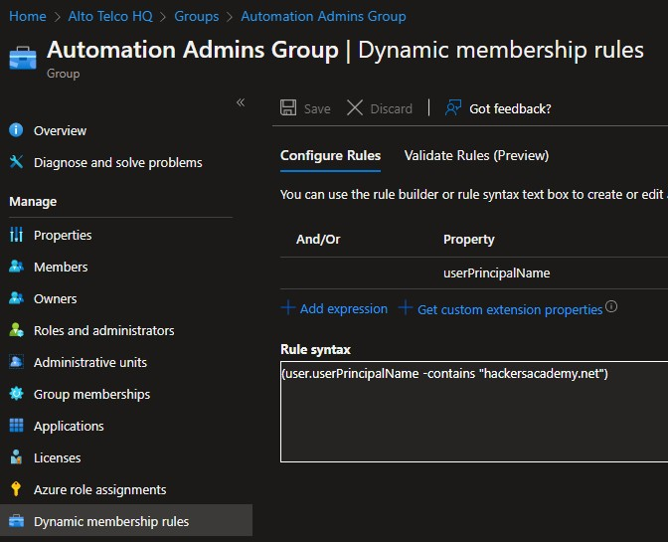

UPN

Slide 105
H o w c a n w e a b u s e t h i s ?
DISCUSSION
I f i t w o r k s , w h a t g r o u p w i l l o u r G u e s t u s e r b e p a r t o f ?
H i n t : S e e p r e v i o u s s c r e e n s h o t

Slide 106
ROLE DEFINITION
107

Slide 107
Definition
Azure AD roles control access to Azure AD resources such as
users, groups, and applications using the Microsoft Graph API
Differs from Azure RBAC for resources
DEFINITION
Components
Security Principal – an ID (user, group or service principal)
Role Definition – collection of permissions
Scope – where the permissions apply

Slide 108
Roles
A collection of permissions
Used to manage authorization AKA delegation in Azure Read, write, action, delete
Built-in – free to use
Custom – requires P1 license
ROLES

Slide 109
Azure AD Roles
Manage access to Azure AD resources
Example add or change users, reset password, manage domain
names, etc.
More than 80 roles (as of April 2023)
Example: Global admin, Global reader, User administrator,
ROLES
Guest inviter

Slide 110
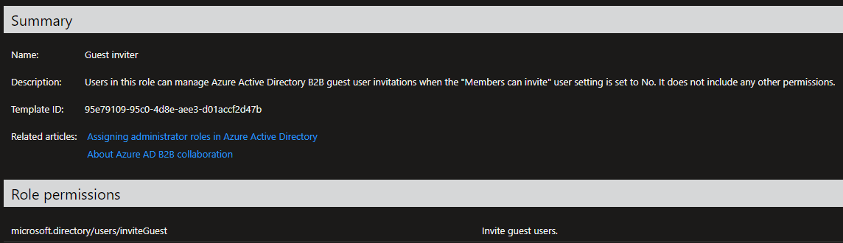
H A C K E R S A C A D E M Y . C O M

Slide 111
SCOPE
H A C K E R S A C A D E M Y . C O M
112

Slide 112
Definition
Azure AD roles control access to Azure AD resources such as
users, groups, and applications using the Microsoft Graph API
Differs from Azure RBAC for resources
DEFINITION
Components
Security Principal – an ID (user, group or service principal)
Role Definition – collection of permissions
Scope – where the permissions apply

Slide 113
Scope Assigned To:
Tenant Administrative Unit Azure AD Resource:
Azure AD Groups
Enterprise Applications
Application Registrations
SCOPE

Slide 114
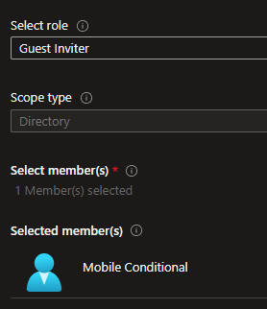
H A C K E R S A C A D E M Y . C O M

Slide 115
PERSISTENCE
116

Slide 116
Persistence
Initial access can be short lived Get “sticky” access
Think multiple channels of persistence
The higher the privileges for the channel, the better
PERSISTENCE
Important!
While pentesting – document everything!
H A C K E R S A C A D E M Y . C O M
117

Slide 117
GUEST USER INVITE
H A C K E R S A C A D E M Y . C O M
118

Slide 118
Add Guest User
By default, users can add (or invite) Guest
Gives read access
If a sync is enabled might give on-prem access
GUEST USERS
H A C K E R S A C A D E M Y . C O M
119

Slide 119
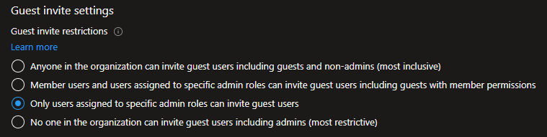

Slide 120




Slide 121
New or Additional
GUEST USERS
A new guest user can be added
With proper permissions, add email to an existing user
H A C K E R S A C A D E M Y . C O M
122

Slide 122


H A C K E R S A C A D E M Y . C O M

Slide 123
Authentication
Guest users authenticate back against their original directory
You’ll need your own Azure subscription to maintain guest access
IMPORTANT
H A C K E R S A C A D E M Y . C O M
124

Slide 124





Slide 125



Slide 126




Slide 127





Slide 128
I n a n o t h e r b r o w s e r …
L o g i n t o p o r t a l . a z u r e . c o m
U s e h a c k e r X @ h a c k e r s a c a d e m y. n e t
MISSION
S w i t c h t e n a n t s
G o t o A l l r e s o u r c e s
W h a t r e s o u r c e s d o y o u h a v e a c c e s s t o ?
E x t r a M i l e
: D o t h e s a m e u s i n g P o w e r S h e l l

Slide 129
Enumerate
Initial Access – Password Spray Defense bypass – Conditional Access
Persistence – Guest user
Privilege Escalation – Dynamic Groups Privilege Escalation – Runbooks Privilege Escalation – Managed Identity Privilege Escalation – Key Vaults
STORY 1

Slide 130
AZURE AD ROLES
&
AZURE RBAC ROLES
131

Slide 131
Azure Resources Roles
AZURE RESOURCES ROLES
AKA IAM or RBAC
Manage access to resources like VM, storage, SQL, etc. Assigned to users, groups, service principals, managed IDs More than 300 roles (as of April 2023)
Example: Contributor, Owner, Reader, VM Contributor
H A C K E R S A C A D E M Y . C O M
132

Slide 132

H A C K E R S A C A D E M Y . C O M

Slide 133
Roles
Three primary:
Owner – full control
Contributor – manage everything except access to resources Reader – view everything but not make changes
PRIMARY ROLES
H A C K E R S A C A D E M Y . C O M
134

Slide 134

https://docs.microsoft.com/en-us/azure/role-based-access-control/role-assignments-portal

Slide 135


Slide 136




Slide 137
Yo u ’ r e a G l o b a l A d m i n i s t r a t o r . I s t h i s A z u r e A D r o l e o r
A z u r e R e s o u r c e r o l e ?
DISCUSSION
D o e s t h i s g i v e y o u f u l l a c c e s s t o A z u r e r e s o u r c e s l i k e
V M s ?

Slide 138


https://learn.microsoft.com/en-us/azure/role-based-access-control/elevate-access-global-admin

Slide 139

https://www.microsoft.com/en-us/security/blog/2023/04/07/mercury-and-dev-1084-destructive-attack-on-hybrid-environment/

Slide 140
Target using the old DirSync (now deprecated)
DirSync Azure AD Connect with Global Admin privileges
Global Admin is Azure AD role
Threat actor needs Azure resources role
Threat actor “elevated” access
MERCURY & FRIENDS

Slide 141
Azure AD roles do NOT grant access to resources Azure resources roles do NOT grant access to Azure AD But…
ELEVATE ACCESS
As a Global Admin you can assign yourself access to resources

Slide 142

H A C K E R S A C A D E M Y . C O M

Slide 143
SERVICE PRINCIPALS
H A C K E R S A C A D E M Y . C O M
144

Slide 144
Azure Resources Roles
AZURE RESOURCES ROLES
AKA IAM or RBAC
Manage access to resources like VM, storage, SQL, etc. Assigned to users, groups, service principals, managed IDs More than 300 roles (as of April 2023)
Example: Contributor, Owner, Reader, VM Contributor
H A C K E R S A C A D E M Y . C O M
145

Slide 145

H A C K E R S A C A D E M Y . C O M

Slide 146
Security Principals
Azure object that we want to assign privileges to
User, group, or service principal
Will have an Object ID
REVIEW…
NOT a Service Principal
See next slide

Slide 147
Service Principal
SERVICE PRINCIPAL
Identity created for use with applications, hosted services and
automated tools
Assigned access to resources
Similar to service accounts in on-prem

Slide 148
3 Types of Service Principal
Application Managed Identity Legacy
SP TYPES

Slide 149


Slide 150
W h o c a n r e g i s t e r a p p l i c a t i o n s b y d e f a u l t ?
DISCUSSION
W h a t d o e s t h i s a l l o w u s t o d o ?

Slide 151


Slide 152
L o g i n a s S P
W h a t p r i v i l e g e s d o y o u h a v e ?
$ Te n a n t I D = " 1 7 e 2 a 9 5 5 - 2 9 1 9 - 4 7 9 8 - b b 9 3 - 2 8 b 9 e f 7 0 5 5 c e "
$ A p p I D = " 7 3 1 d c 0 c 2 - 2 f d 2 - 4 0 3 f - 9 1 b c - 9 8 4 2 2 7 2 6 e b e f "
$ A p p S e c r e t =
" F 1 R 8 Q ~ P t e p 5 8 S G y T 6 r 4 S y k 7 Z p z Q a b V 3 d 6 b r t Z c c . "
$ S e c u r e S t r i n g = $ A p p S e c r e t | C o n v e r t To - S e c u r e S t r i n g -
A s P l a i n Te x t - F o r c e
$ C r e d e n t i a l = N e w - O b j e c t - T y p e N a m e
S y s t e m . M a n a g e m e n t . A u t o m a t i o n . P S C r e d e n t i a l - A r g u m e n t L i s t $ A p p I D ,$ S e c u r e S t r i n g
MISSION
C o n n e c t - A z A c c o u n t - S e r v i c e P r i n c i p a l - C r e d e n t i a l
$ C r e d e n t i a l - Te n a n t I d $ Te n a n t I D

Slide 153
C r e a t e a S P b y r e g i s t e r i n g y o u r o w n a p p
EXTRA MILE
L o g i n w i t h t h e S P u s i n g p r e v i o u s P o w e r S h e l l c o m m a n d s
D o y o u h a v e a n y p r i v i l e g e s ?

Slide 154
Service Principal Management
It’s a challenge
Create SP > Grant permissions > Set credentials > Store credentials
> Rotate credentials > Clean up credentials > Delete SP
SP MANAGEMENT
MS introduced Managed Identities…

Slide 155
Service Principal
Create SP > Grant permissions > Set credentials > Store credentials
> Rotate credentials > Clean up credentials > Delete SP
MANAGED IDENTITY
Managed ID
Resource to resource communication
Create resource with Managed ID > Grant permissions > Delete resource

Slide 156
PRIVILEGE ESCALATION
157

Slide 157
Vertical Vs. Horizontal
Vertical: going higher
Horizontal: other resources with different privs
PRIV ESC

Slide 158
Multiple Routes
Search VMs for keys, environment variables, etc. Apps
App functions Containers
Dynamic memberships Azure Resource Manager General misconfigurations Etc.
PRIV ESC

Slide 159
AUTOMATION ACCOUNTS
160

Slide 160
Automation Accounts
Holds automation configuration to automate operations
For example, holds resources like Runbooks
To access other resources:
Run As, not recommended (retires 30 Sept 2023)
Managed Identities
AUTOMATION ACCOUNTS
H A C K E R S A C A D E M Y . C O M
161

Slide 161



Slide 162




Slide 163
Runbooks
Think of it as a task scheduler Require an automation account Uses PowerShell or Python Can have Webhooks
RUNBOOKS
H A C K E R S A C A D E M Y . C O M
164

Slide 164



Slide 165




Slide 166




Slide 167
Webhooks
Start runbook with a single HTTP request Not created by default
Can be used by anyone from anywhere (on the web) Valid for 10 years (extendable)
WEBHOOKS
Security
Relies on the privacy of the URL (contains a token) No authentication
H A C K E R S A C A D E M Y . C O M
168

Slide 168


Slide 169
I n s t r u c t o r w i l l s t a r t S t a r t - VM
MISSION
Yo u s t a r t G e t - M g d I D - To k e n r u n b o o k
K e e p a n e y e o n t h e O u t p u t . W h a t d i d y o u g e t ?

Slide 170
D o N O T c h a n g e t h e M g d I D - W i n 1 0 V M
U s e t h e R u n b o o k - Me - W i n 1 0 VM
C r e a t e a r u n b o o k w i t h t h e a d d - u s e r s c r i p t
EXTRA MILE
U s e y o u r o w n c r e d e n t i a l s
h t t p s : / / g i t h u b . c o m / D e a n O f C y b e r / A z u r e -
P e n e t r a t i o n - Te s t i n g / b l o b / m a i n / P o w e r S h e l l / A d d -
L o c a l A d m i n . p s 1
A c c e s s t h e V M ( 2 0 . 2 3 0 . 6 . 2 3 6 )

Slide 171
Enumerate
Initial Access – Password Spray Defense bypass – Conditional Access
Persistence – Guest user
Privilege Escalation – Dynamic Groups Privilege Escalation – Runbooks Privilege Escalation – Managed Identity Privilege Escalation – Key Vaults
STORY 1

Slide 172
MANAGED IDENTITY
173

Slide 173
Service Principal
Create SP > Grant permissions > Set credentials > Store credentials
> Rotate credentials > Clean up credentials > Delete SP
REVIEW…
Managed ID
Resource to resource communication
Create resource with Managed ID > Grant permissions > Delete resource

Slide 174
VM Managed ID
VMs could have a Managed ID System assigned: tied to the resource
User assigned: can be used with multiple resources
Could have higher privileges
Can be used to retrieve the Managed ID token
VM MANAGED IDENTITY

Slide 175




Slide 177




Slide 178
Tokens
Bearer token. Can be used with: HTTP, PS, curl, etc.
Azure Resource Manager
Key Vault
VM TOKEN REQUEST
Prerequisites VM (obviously ☺) Managed Identity
H A C K E R S A C A D E M Y . C O M
179

Slide 179

H A C K E R S A C A D E M Y . C O M

Slide 180
Azure Instance Metadata Service
Provides information about currently running VM instances
Available for running instances of virtual machines
REST API that's available at a well-known, non-routable IP
address (169.254.169.254)
Only accessibly from within the VM
IMDS
H A C K E R S A C A D E M Y . C O M
181

Slide 181


Slide 182


Slide 183



Slide 184
G e t t h e t o k e n s f r o m t h e l a t e s t r u n b o o k
N o t i c e t h e r e a r e t w o : M a n a g e m e n t a n d K e y v a u l t
MISSION
U s e t h e M a n a g e m e n t t o k e n t o l o g i n a s t h e M a n a g e d I D ( r e m o v e a l l s p a c e s )
W h a t a r e y o u r A z R o l e A s s i g n m e n t ?

Slide 185


Slide 186
G o t o A u t o m a t i o n A c c o u n t s > V M s - A u t o - A c c o u n t >
R u n b o o k s > C r e a t e a r u n b o o k
R u n b o o k t y p e P o w e r S h e l l , R u n t i m e v e r s i o n 5 . 1
P a s t e t h e c o d e > S a v e > P u b l i s h
DIY MISSION
G o b a c k t o r u n b o o k a n d r e f r e s h
C l i c k o n y o u r r u n b o o k
S t a r t b u t t o n w i l l b e g r e y e d o u t . P l e a s e w a i t f o r a w h i l e O n c e t h e s t a r t b u t t o n i s a v a i l a b l e , s t a r t y o u r r u n b o o k
a n d s e e t h e o u t p u t f o r t h e t o k e n

Slide 187
Enumerate
Initial Access – Password Spray Defense bypass – Conditional Access
Persistence – Guest user
Privilege Escalation – Dynamic Groups Privilege Escalation – Runbooks Privilege Escalation – Managed Identity Privilege Escalation – Key Vaults
STORY 1

Slide 188
KEY VAULTS
189

Slide 189
Secrets
Used for storing and accessing keys, secrets and/or certs Secrets can be protected by Access Policies or RBAC
Access Policies can be abused by Contributor to self-permit reading
secrets
KEY VAULTS

Slide 190
Access Policies
ACCESS POLICIES
Determines what actions a Security Principal can do
No longer recommended by Microsoft
But migrating to RBAC is a challenge, so they stay

Slide 191


https://docs.microsoft.com/en-us/azure/key-vault/general/security-features

Slide 192


Slide 193
More Granular
Manage access to resources like VM, storage, SQL, etc. Control access to individual keys or secrets
Roles assigned to Security Principals (example Managed ID)
RBAC
H A C K E R S A C A D E M Y . C O M
194

Slide 194


Slide 195


Slide 196



Slide 197



Slide 198
U s e t h e M a n a g e d I D t o g e t v a u l t t o k e n
MISSION
U s e t h e t o k e n r e t r i e v e s e c r e t v a l u e
G e t t h e l o g i n c r e d e n t i a l s f o r t h e v m . a d m i n a c c o u n t

Slide 199
G e t - A z K e y Va u l t
$ v t o k e n = " e y J 0 e X A … "
I n v o k e - W e b R e q u e s t - U r i h t t p s : / / a l t o t e l -
k e y v a u l t - by - r b a c . v a u l t . a z u r e . n e t / s e c r e t s / v m - a d m i n - p a s s / ? a p i - v e r s i o n = 7 . 3 - M e t h o d G e t -
MISSION SOLUTION
H e a d e r s @ { A u t h o r i z a t i o n = " B e a r e r $ v t o k e n " } -
U s e B a s i c P a r s i n g | C o n v e r t F r o m - Json
I n v o k e - W e b R e q u e s t - U r i h t t p s : / / a l t o t e l -
k e y v a u l t - by - r b a c . v a u l t . a z u r e . n e t / s e c r e t s / v m - a d m i n - p a s s / ? a p i - v e r s i o n = 7 . 3 - M e t h o d G e t -
H e a d e r s @ { A u t h o r i z a t i o n = " B e a r e r $ v t o k e n " } - U s e B a s i c P a r s i n g | C o n v e r t F r o m - Json

Slide 200
W h y c a n w e r e a d s e c r e t s f r o m a l t o t e l - k e y v a u l t - by - r b a c ?
DISCUSSION
W h y c a n ’ t w e r e a d f r o m a l t o t e l - k e y v a u l t - by - p l c y ?

Slide 201
Enumerate
Initial Access – Password Spray Defense bypass – Conditional Access
Persistence – Guest user
Privilege Escalation – Dynamic Groups Privilege Escalation – Runbooks Privilege Escalation – Managed Identity Privilege Escalation – Key Vaults
To be continued…
STORY 1

Slide 202
Key vault secret Azure Web app ACR pull
Docker inspect App registration
STORY 2

Slide 203
AZURE APP SERVICES
204

Slide 204
HTTP-based
Host web apps, REST API, mobile back ends
.NET, .NET Core, Java, Ruby, Node.js, PHP, or Python, Docker
Windows and Linux Custom domains
APP SERVICES

Slide 205
Classic Web Vulnerabilities
OS command injection
Server Side Template Injection
File upload
Etc.
Can have a managed ID
APP SERVICES VULNS

Slide 206

H A C K E R S A C A D E M Y . C O M

Slide 207
AZURE CONTAINER REGISTRIES
H A C K E R S A C A D E M Y . C O M
208

Slide 208
Image
Composed from Dockerfile
CONTAINER LIFECYCLE
Registry
Stores images
Container
Running image
H A C K E R S A C A D E M Y . C O M
209

Slide 209

H A C K E R S A C A D E M Y . C O M

Slide 210
Anonymous Pull Anonymous (unauthenticated) pull Any user can pull from the registry
ANONYMOUS ACCESS
Makes content publicly available (not just for auth users)
Requires SKU Standard and Premium
Applies to ALL repositories in the registry

Slide 211
Reader User Can
Access registry
Look for images in all their versions (tags) Pull images
Run containers
READER ACCESS

Slide 212
Admin Access Admin access to registry Mainly for testing purposes
ADMIN ACCESS
Sometimes enabled and forgotten

Slide 213






Slide 214



Slide 215


Slide 216




Slide 217
U s e v m . a d m i n t o r e t r i e v e t h e A C R a d m i n p a s s w o r d
MISSION
L i s t r e g i s t r y c o n t e n t s a n d p u l l i m a g e s
I n s p e c t t h e i m a g e s

Slide 218
d o c k e r l o g i n a l t o t e l a c r . a z u r e c r . i o - u a l t o t e l a c r
MISSION SOLUTION
d o c k e r p u l l a l t o t e l a c r . a z u r e c r . i o / l e a k y -
a c i : l a t e s t
d o c k e r i n s p e c t a l t o t e l a c r . a z u r e c r . i o / l e a k y - a c i : l a t e s t

Slide 219
Key vault secret Azure Web app ACR pull
Docker inspect App registration
STORY 2

Slide 220
APP SERVICE
221

Slide 221
Service Principals Apps have Service Principals Can be assigned roles
APP SP
Often too permissive because “it just works”
H A C K E R S A C A D E M Y . C O M
222

Slide 222



H A C K E R S A C A D E M Y . C O M

Slide 223
Certificates & Secrets
The password for the Service Principal
Allows the app to prove its identity when requesting a token
App owner can add multiple secrets
APP SECRETS
H A C K E R S A C A D E M Y . C O M
224

Slide 224


Slide 225


Slide 226


Slide 227
U s e t h e s e c r e t s f o u n d i n t h e i m a g e t o a u t h e n t i c a t e a s t h e a p p S e r v i c e P r i n c i p a l
MISSION
W h a t n e w p r i v i l e g e s d o y o u h a v e ?

Slide 228
Key vault secret Azure Web app ACR pull
Docker inspect App registration
STORY 2

Slide 229
AZURE STORAGE
230

Slide 230
Azure Storage
AZURE STORAGE
Cloud storage solution
Reliable, secure, scalable, managed and accessible…
… Stored objects accessible using HTTP/S and REST API

Slide 231
Blob – big volumes of unstructured data, text or binary
Files – file share accessed using SMB, NFS or REST APIs
Queue – storage and retrieval of messages
Table – NoSQL (Cosmos DB)
Disk – Azure Managed Disk (VHD)
NetApp Files – enterprise class, high performance
STORAGE TYPES

Slide 232
STORAGE ENDPOINTS
Standard Endpoints
Storage service | Endpoint
Blob Storage | https://<storage-acnt>.blob.core.windows.net
Static Website | https://<storage-acnt>.web.core.windows.net
Data Lake | https://<storage-acnt>.dfs.core.windows.net
Azure Files | https://<storage-acnt>.file.core.windows.net
Queue Storage | https://<storage-acnt>.queue.core.windows.net
Table Storage | https://<storage-acnt>.table.core.windows.net

Slide 233
STORAGE ACCOUNT
Contains all storage objects: blobs, file shares, tables, etc. Unique name across ALL of Azure (3-24 chars)
Stored objects accessible from anywhere over HTTP or HTTPS

Slide 234


H A C K E R S A C A D E M Y . C O M

Slide 235
CONTAINERS & BLOBS
H A C K E R S A C A D E M Y . C O M
236

Slide 236
Container
A collection of blobs. Like a directory
CONTAINERS & BLOBS
Blob
Unstructured data storage
Files like jpg, txt, etc.
Common for serving images, audio, video, backups

Slide 237
Access
Public: access and file listing allowed without authentication
Private: no anonymous access
Blob: anonymous access possible with knowledge of URL. No file listing allowed
Container: anonymous access allows listing of files
ACCESS LEVELS

Slide 238


Slide 239





Slide 240


Slide 241


Slide 242


Slide 243


Slide 244
Container/Blob Authorization
Anonymous
Shared Access Signature
Active Directory
Storage Account Shared Key – Storage account level
AUTHORIZATION
H A C K E R S A C A D E M Y . C O M
245

Slide 245
H A C K E R S A C A D E M Y . C O M

Slide 246
SHARED ACCESS SIGNATURE
SAS
Limited access via a URI Could be time limited
Signed by Azure AD credentials or by account Shared Key
H A C K E R S A C A D E M Y . C O M
247

Slide 247





H A C K E R S A C A D E M Y . C O M

Slide 248
Storage Account
Active Directory
Storage Account Shared Key
AUTHORIZATION

Slide 249
Shared Key
512-bit access keys for storage accounts Not recommended but enabled by default!
Key is like the root password for storage account
Access to the shared key grants a user full access to a storage account’s configuration and its data
SHARED KEY

Slide 250
The Risk
Access to keys grant full access to a storage account’s
configuration and its data
Recent research (April 2023) shows this can lead to RCE by
abusing Azure Functions
SHARED KEY

Slide 251


Slide 252


Slide 253
Yo u h a v e a s h a r e d k e y f r o m a c c e s s i n g t h e k e y v a u l t s
MISSION
e a r l i e r
U s e i t t o f u l l y c o m p r o m i s e t h e s t o r a g e a c c o u n t

Slide 254
VIRTUAL HARD DISKS
255

Slide 255
VHD
Usually stored in storage accounts Hard disk images for VMs
Contain data stored on VMs
Potentially create/download snapshot
Mount snapshot to access data
VIRTUAL HARD DISK

Slide 256
Disk Snapshot
If a snapshot exists, you can download it Alternatively, we can create one
Mount it (example using Kali)
Extract SAM and SYSTEM files
Use impacket to extract the hashes
HASHES FROM VM

Slide 257


Slide 258


Slide 259


Slide 260
s u d o a p t u p d a t e
s u d o a p t i n s t a l l n t f s - 3 g - y s u d o f d i s k - l
L o o k f o r t h e M i c r o s o f t s d b ( e . g . / d e b / s d c 4 )
s u d o m
s u d o m o u n t / d e v / s d c 4 / m e d i a / m y - m o u n t e d - d r i v e / k d i r
/ m e d i a / m y - m o u n t e d - d r i v e
I g n o r e e r r o r s
c d / m e d i a / m y - m o u n t e d - d r i v e / W i n d o w s / S y s t e m 3 2 / c o n f i g /
c p S A M S Y S T E M ~
c d ~
s u d o a p t i n s t a l l p y t h o n 3 - i m p a c k e t - y
i m p a c k e t - s e c r e t s d u m p - s y s t e m S Y S T E M - s a m S A M
L O C A L
DIY MISSION

Slide 261
Look Around!
We focused on the hashes But you have full disk access Look around!
REMEMBER
262

Slide 262
DISCUSSION
W h a t c a n y o u d o w i t h t h e h a s h e s ?

Slide 263
BONUS SECTION

Slide 264
VM RUN COMMANDS
H A C K E R S A C A D E M Y . C O M

Slide 265
Run Command
VM RUN COMMAND
Run commands or PS Scripts VM Contributor role or higher
Commands run as nt authority\system Can be run from portal or PS
H A C K E R S A C A D E M Y . C O M
266

Slide 266


Slide 267


Slide 268



Slide 269
G e t - A z V M
VM RUN COMMAND
I n v o k e - A z V M R u n C o m m a n d -
R e s o u r c e G r o u p N a m e “ R G N a m e " - V M N a m e
“ V M N a m e " - C o m m a n d I d
" R u n P o w e r S h e l l S c r i p t " - S c r i p t P a t h . \ add - u s e r . p s 1

Slide 270
C r e a t e K a l i i n s t a n c e
DIY MISSION
A l l o w i n b o u n d p o r t
G e t r e v e r s e s h e l l f r o m V M t o K a l i

Slide 271


Slide 272


Slide 273
THANK YOU!
H A C K E R S A C A D E M Y . C O M
274

